Slide 1
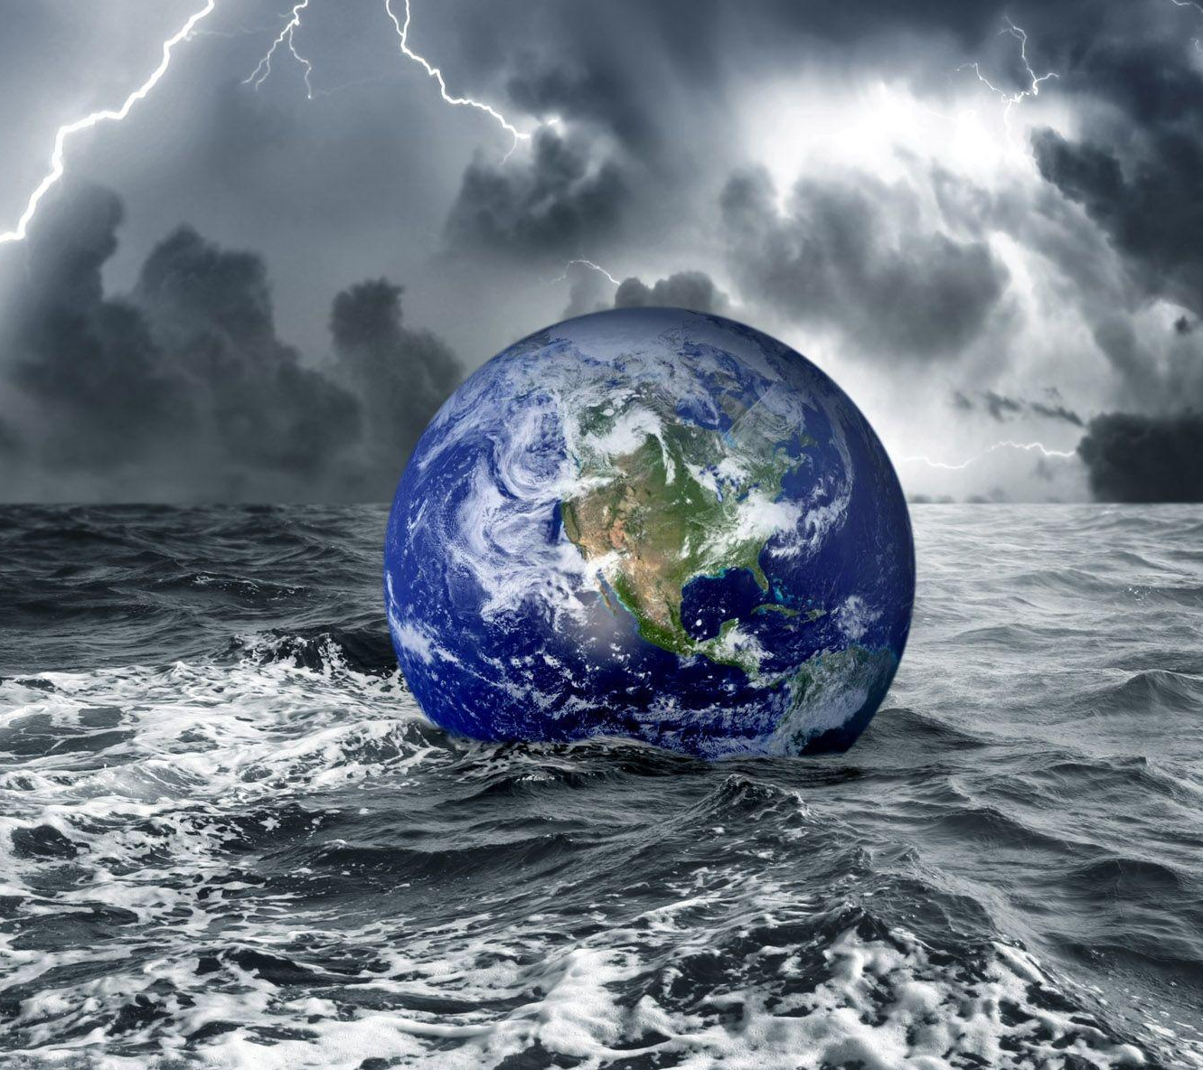
A Deep Learning Approach for Flood Detection from Social Media Imagery
Professor: Dr. Eduardo Chan
Group 1:
Nupur Pathak
Revathi Boopathi
Sree Divya Cheerla
Vani Bhat
Notes:
https://www.google.com/imgres?imgurl=https%3A%2F%2Fwallpapercave.com%2Fwp%2Fwp2079063.jpg&imgrefurl=https%3A%2F%2Fwallpapercave.com%2Fflood-wallpapers&tbnid=j13Upok6VwmEyM&vet=10CA4QxiAoC2oXChMIwLKG7YLN-wIVAAAAAB0AAAAAEAY..i&docid=YPhjMPeMKbLc9M&w=1920&h=1200&itg=1&q=flood%20disaster%20hd%20wallpaper%20portrait&hl=en&ved=0CA4QxiAoC2oXChMIwLKG7YLN-wIVAAAAAB0AAAAAEAY

Slide 2
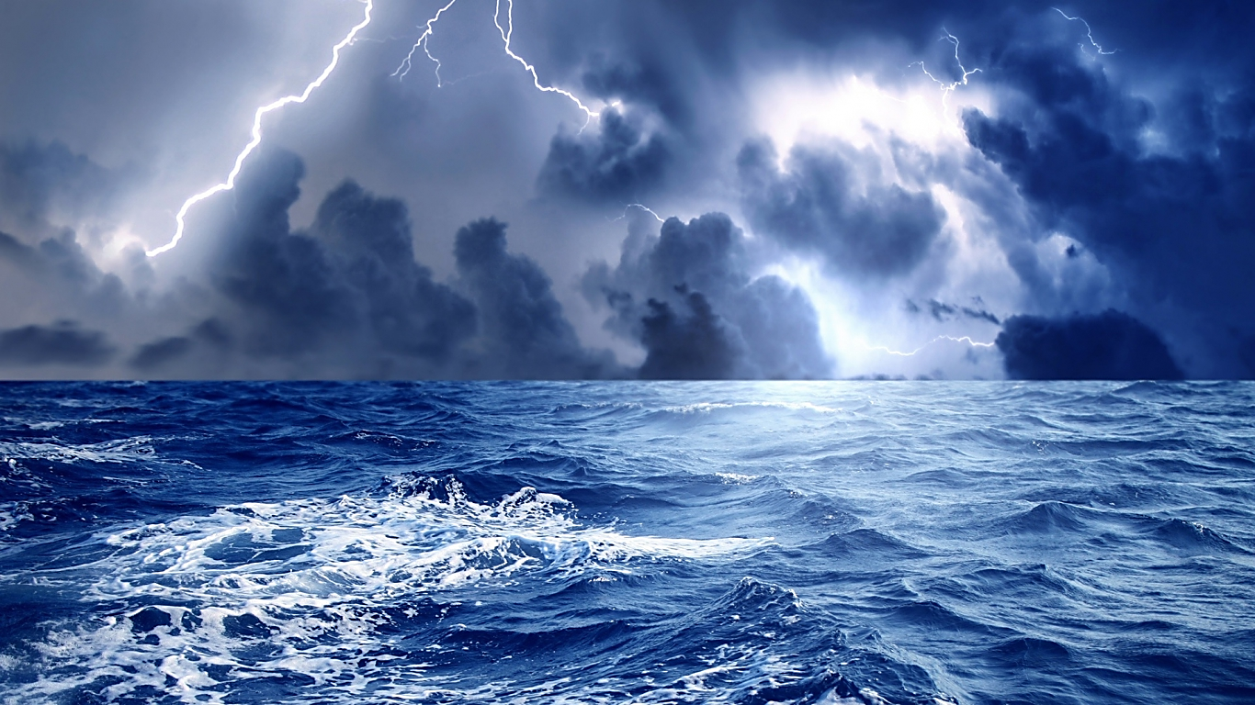
Agenda
Project Background and Executive Summary
Project Requirements and Plan
Project Literature and Technology Surveys
Project Required Resources, Technology and Platform
Data Collection and Preparation
Deep Learning Models

Slide 3
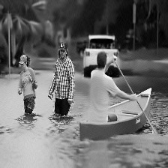
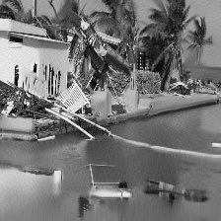
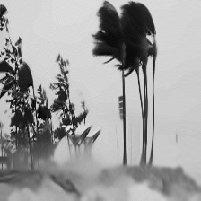
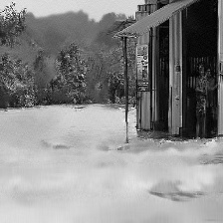
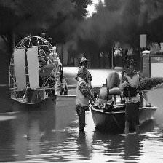
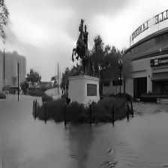
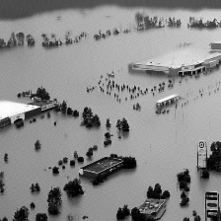
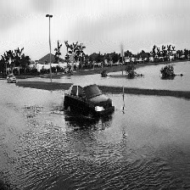
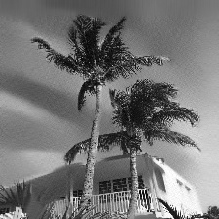
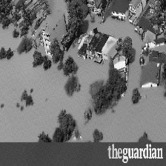
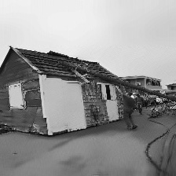
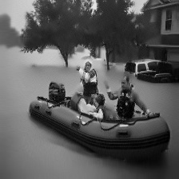
PROJECT BACKGROUND and executive summary

Slide 4

Project background
Droughts, floods, wildfires, rising sea levels, pollution, etc., are the impacts of climate change which are affecting humans and wildlife. The consequences of climate change are alarming and need quick action to get under control.
The occurrence of natural disasters like floods, earthquakes, wildfires, etc., is something that is out of the control of human beings. They take place naturally causing extensive damage to our environmental surroundings such as infrastructure and people.

Slide 5
Project Motivation
As per the report published by the World Meteorological Organization in 2021, "44% of disasters have been associated with floods (riverine floods 24%, general floods 14%) and 17% have been associated with tropical cyclones".
World Health Organisation (WHO) in 2022 stated that "Floods are the most frequent type of natural disaster, and this trend is expected to continue, and are often caused by heavy rainfall, rapid snowmelt or a storm surge from a tropical cyclone or tsunami in coastal areas".
WHO also say’s that "Drowning accounts for 75% of deaths in flood disasters". Having known the statistics on the extent of damage floods can cause, we think finding a solution that could help save lives and the environment is the need of the hour.
1
2
3

Slide 6
PROBLEM, GOAL, AND NEEDS
Target Problem
Goal and Needs
It is extremely hard to get information on the circumstances immediately, during and after flood disaster.
People are unable to get necessary immediate assistance causing loss of lives.
The goal of the research is to classify the images accumulated from the Twitter as flood / non-flood by leveraging various deep learning technologies.
It can help various disaster management firms provide necessary emergency responses and save lives.

Slide 7
PROJECT Deliverables
Project proposal
Introduction
PM Tool and Work Breakdown structure
Effort Estimates, PERT and GANTT Chart
Data and Project Management Plan
Data Collection and Data Exploration
Data Engineering
Abstract
Project Presentation
Individual Research Paper on Model Development
Final Group Project Report

Slide 8
PROJECT REQUIREMENTS AND PLAN

Slide 9
PROJECT Requirements
Functional Requirements that can be Tested and Measurable
Google Collab with google drive mounted on it to access data and train/test model using GPU.
AI-powered Requirements that can be Tested and Measurable
CNN models for Image classification and object detection like VGGNet, ResNet, AlexNet, and GoogleNet
Data Requirements
Dataset consisting of images collected at the flood disaster location

Slide 10
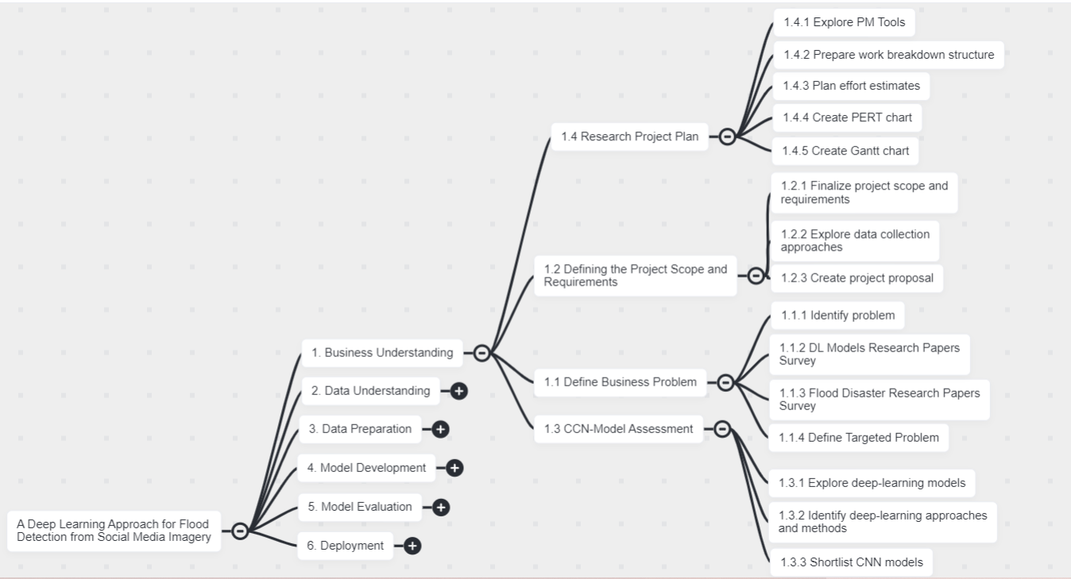
WORK BREAKDOWN STRUCTURE (1/3)
BUSINESS UNDERSTANDING
Note: WBS Structure created using ClickUp tool

Slide 11
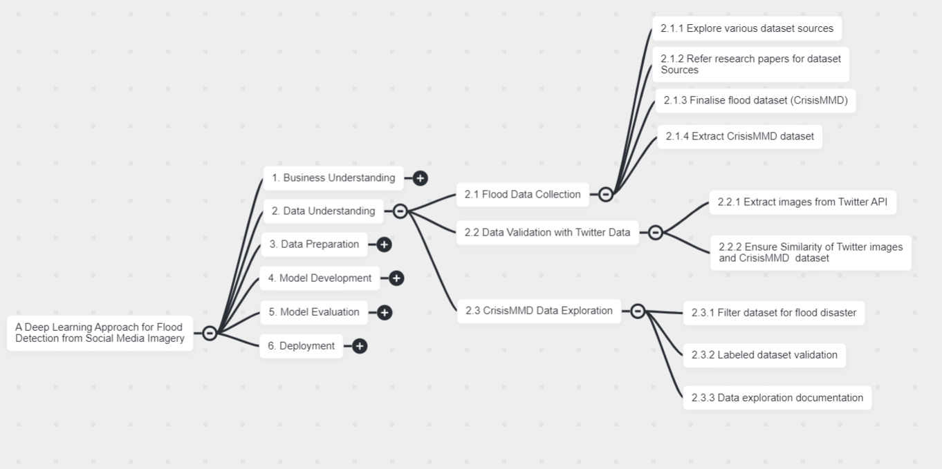
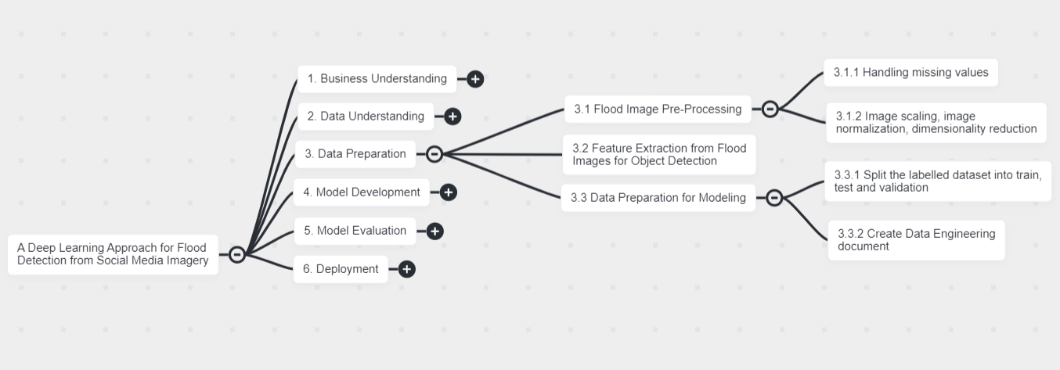
WORK BREAKDOWN STRUCTURE (2/3)
DATA UNDERSTANDING
DATA PREPARATION
Note: WBS Structure created using ClickUp tool

Slide 12
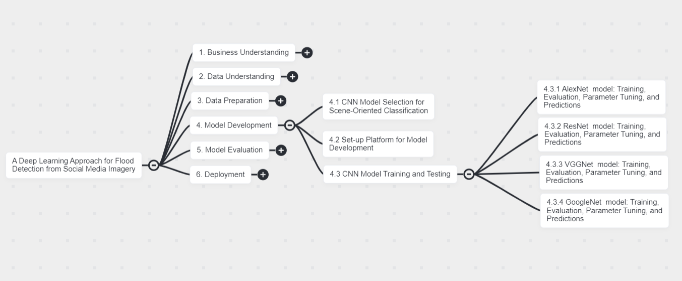
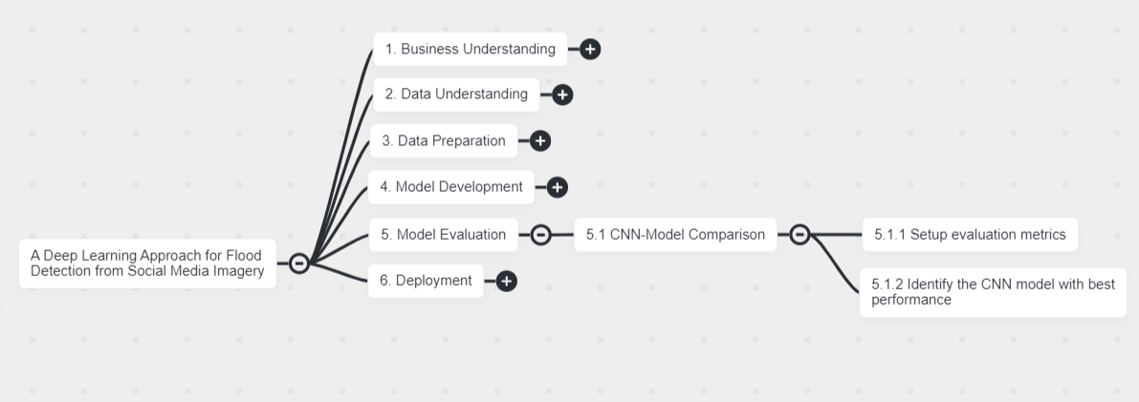
WORK BREAKDOWN STRUCTURE (3/3)
MODEL DEVELOPMENT
MODEL EVALUATION
Note: WBS Structure created using ClickUp tool

Slide 13
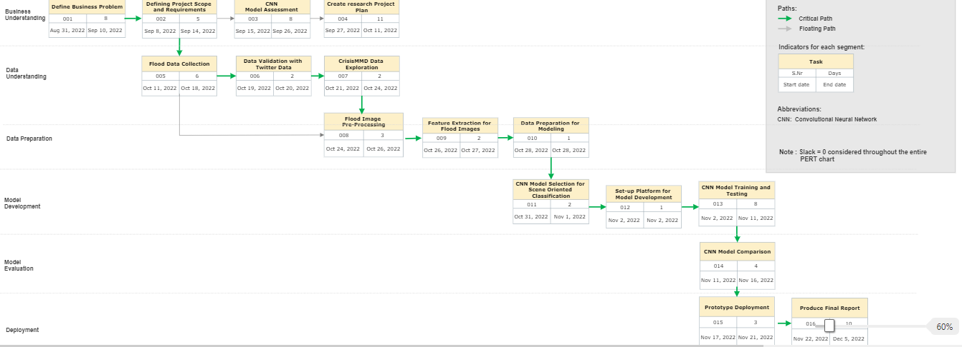
PERT CHART
Note: PERT chart created using SmartDraw tool
Notes:
Note: PERT Chart is created using ClickUp tool

Slide 14
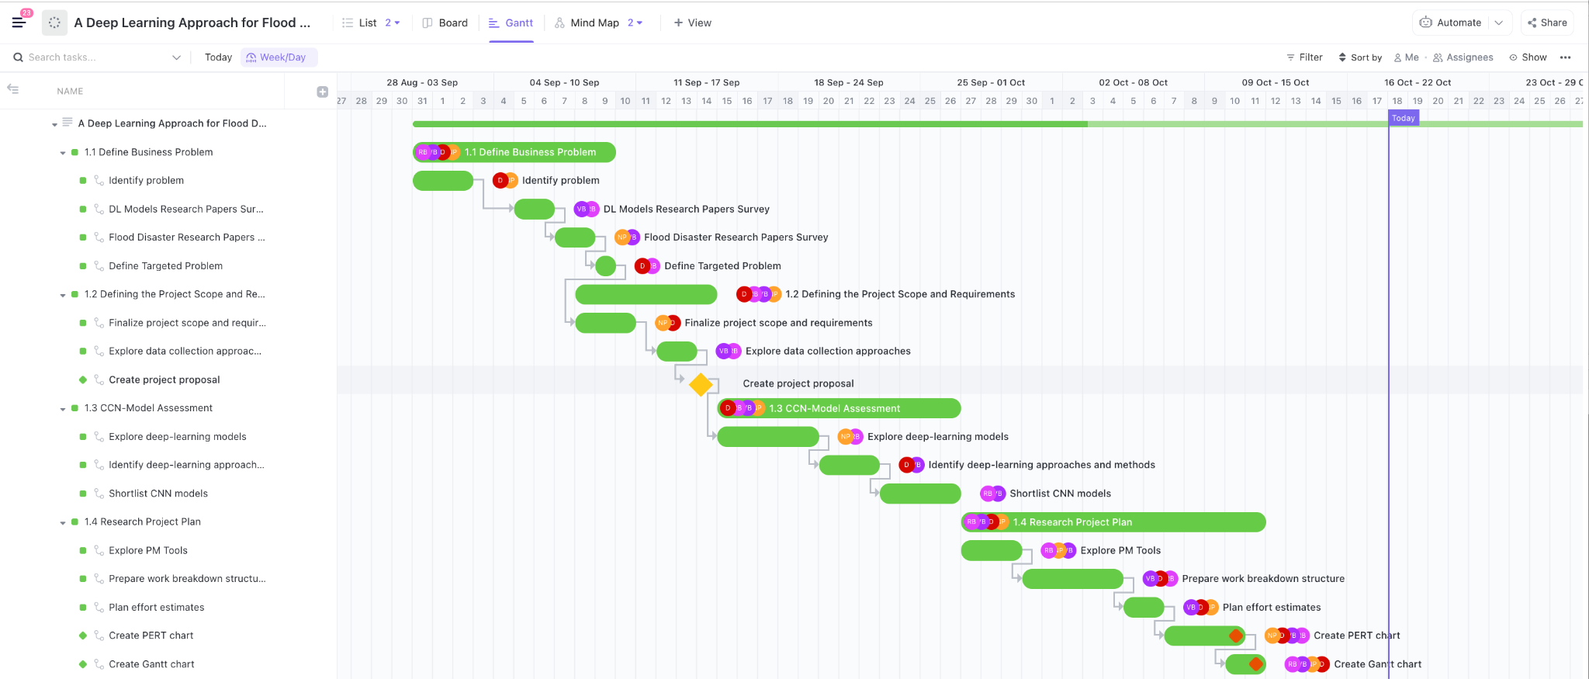
GANTT CHART
Note: Gantt chart created using ClickUp tool
Notes:
Note: PERT Chart is created using ClickUp tool

Slide 15
Project Literature AND Technology Surveys

Slide 16
SUMMARY
We have researched about 10 - 12 research papers where we found that deep learning models are the best suited for image classification. For flood detection and monitoring, social media, UAVs, and satellite images are generally used as the data source We have divided our research into sections based on the source from where the image was captured, like social media, UAV, and satellite imagery, and tried to compare and contrast the techniques used by each author for the practical application of flood detection and monitoring and also the limitations with each dataset.
From the literature survey we have observed that CNN models like ResNet, AlexNet, VGGNet, GoogleNet, DeepNetV3+ are widely used and the results are compared using metrics accuracy, precision, recall, loss, memory consumption, etc. It is observed that there is no existing best approach for image classification and size, type of the data and expected results should be considered while selecting a model for the required application.

Slide 17
SURVEYs
Dataset | Authors* | Models used | Metrics used
Social media images | Alam et al. (2020) Jony et al. (2019) Nguyen et al. (2022) Asif et al. (2021) | ResNet18/50/101 VGG-16 InceptionNet AlexNet DenseNet SqueezeNet MobNet(v2) EffiNet (b1) GoogleNet | #L(P) - Number Of Layers And Parameters Used Mem. - Memory Consumption Mean Average Precision(MAP) Accuracy Precision Recall F1
Satellite Images | Montello et al. (2022) Bocanegra and Haddad (2021) Drakonakis et al. (2022) | ResNet50 and UNet ResNet50 and DeepLabV3+ TResNet and UNet TResNet and DeepLabV3+ EfficientNet and UNet ​​DenseNet121 and PSPNet DenseNet121 and UNet AlexNet GoogleNet ResNet | Precision Recall IoU F1 score Specificity
UAV images | Rahnemoonfar et al. (2021) Kyrkou and Theocharides (2019) Zhang et al. (2021) | ENet DeepLabv3+ PSPNet InceptionNetv3 ResNet50 Xception VGG16 ERNet MobileNet | Per-Class Intersection Over Union Mean Value (mIoU) Accuracy Processing Time, Frames-Rate, Speedup, Memory F1 score
Commonly used models and metrics
*Details on the papers are provided in the reference slide

Slide 18
PROJECT REQUIRED RESOURCES, TECHNOLOGY AND PLATFORM

Slide 19
PROJECT RESOURCES, TECH and PLATFORM
Resource Type ( Hardware / Software / Tools ) | Resource | Specification / Configuration / Version | License | Cost | Justification / Purpose
Hardware | PC/MAC System | 8-core processor, 32 GB RAM, and greater than 256 GB storage space. | - | $ 1500 | Developmental activities, training, and testing of model
Hardware | Graphics Processing Unit (GPU) in Google Collab | K80 GPU and 12 GB RAM | - | $ 0 | Training and testing deep learning model with GPU
Software | MacOS / Windows OS 11 | 12.6/11 | - | $ 0 | Manage computer resources like CPU and provide services for software
Software | Anaconda distribution package for MAC/Windows | Python 3.9 | Open source |  | Integrated development environment platform to experiment code
Software | Python packages/libraries (NumPy, Pandas, SciPy, Sklearn, Matplotlib) | The latest versions installed/ updated with Python 3.9 | Open source | $ 0 | For exploratory data analysis
Software | OpenCV | 4.5.1 | Open source | $ 0 | Image pre-processing
Software | TensorFlow 2 and Keras | 2 | Open source | $ 0 | Model development and implementation
Tool | Google Collab / Jupyter notebook | 3.9 | Open source | $ 0 | Integrated development environment for model development

Slide 20
PROJECT RESOURCES, TECH and PLATFORM CONTD.
Resource Type ( Hardware / Software / Tools / Application ) | Resource | Specification / Configuration / Version | License | Cost | Justification / Purpose
Tool ( Cloud-based collaboration and project management ) | ClickUp | - | Paid | $ 36 | To manage, plan, and track the workflows of our research project in one place.
Software (Cloud based storage service) | Google Drive | - | Open Source | $ 0 | File storage and synchronization service
Software | Zoom | Client version 5.8. 6 or higher | Open Source | $ 0 | Collaborate with team members for group work
Application | Google Meet | - | Open Source | $ 0 | Collaborate with team members for group work

Slide 21
DATA COLLECTION AND PREPARATION

Slide 22



COLLECTION & PREPARATION PROCESS FLOW
Exploratory Data Analysis (EDA)
Image parameter analysis (height, width, etc.,)
Pixel distribution
Label wise image distribution
Image Preprocessing
Resizing
Gray scaling
Normalization
Reduction
Manual Annotation
Consolidated data source
(CRISISMMD)
Revising labels
Balancing Image Data
API
Twitter
Data Validation
Splitting

Slide 23
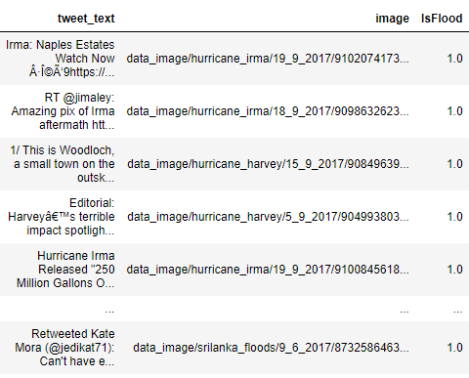
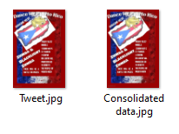
Collection
Consolidated data source
(CRISISMMD)
Size: 1.57 GB
API
Manual Annotation
Revise labels
Twitter
Data Validation
Perform pixel wise equality check in python

Slide 24
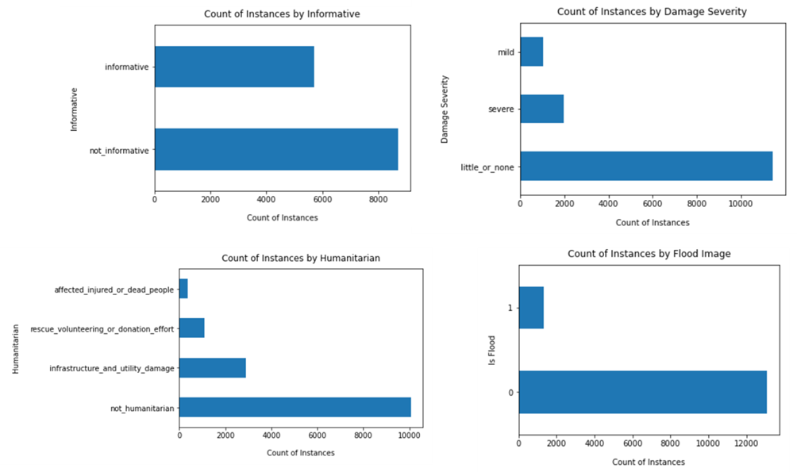
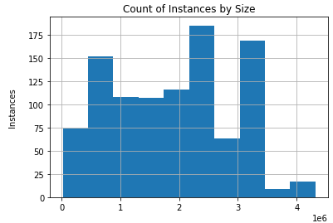
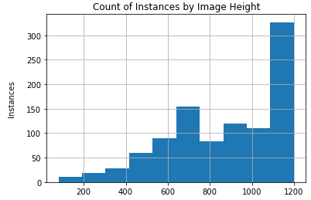
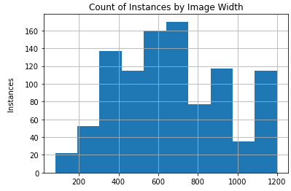
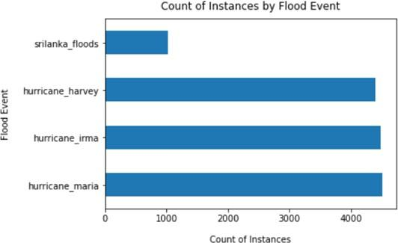
Exploratory Data Analysis
Image Distribution by label
Image Distribution by parameters
Image Distribution by Flood Event

Slide 25

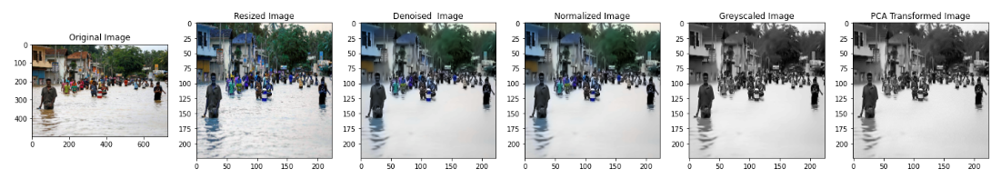
Data balancing & preprocessing
Data Balancing
Unbalanced Dataset
Down sampling of non flood images
Sample 1000 balanced image data
Image Pre-processing
Pre-processing steps performed on the sampled 1000 images

Slide 26
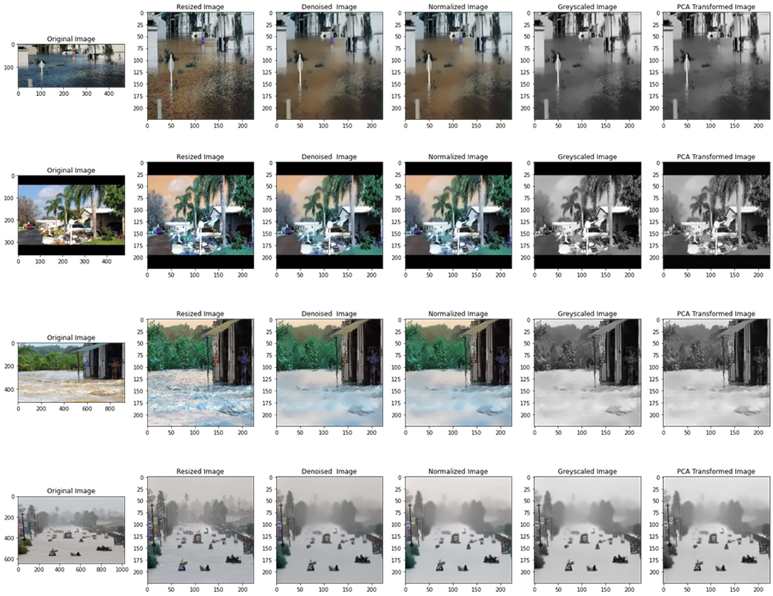
Data PRE-PROCESSING (CONTD.)

Slide 27
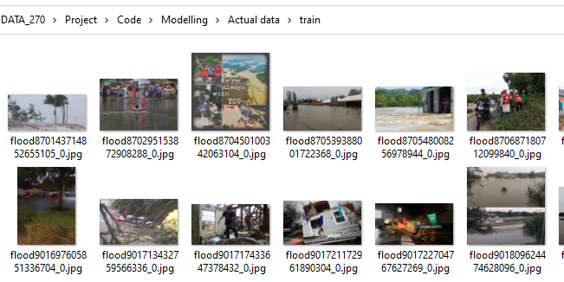
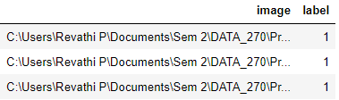
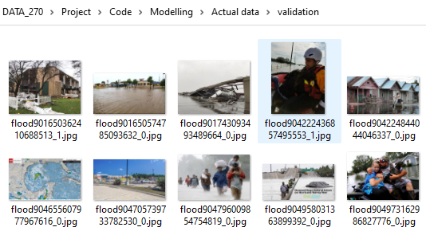
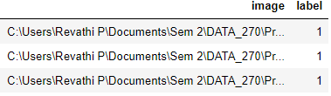
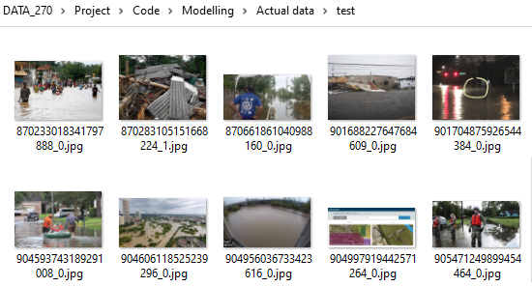
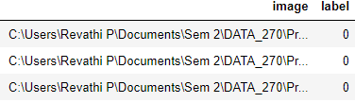
Data splitting
Train
60%
Pre-processed Image Data
Validation
20%
Test
20%

Slide 28
deep LEARNING MODELS

Slide 29
MODEL Selection
CNN Model | Number of Layers | Model Description | Year | Supported Data
AlexNet | 8 | 5 convolutional layers and 3 fully connected layers | 2012 | Image
VGG-16 | 16 | 13 convolutional layer and 3 fully connected layers | 2014 | Image
GoogleNet | 22 | 22 layers and 5 max pooling layers with 9 inception blocks | 2014 | Image, Audio, Video, Tabular
ResNet-50 | 50 | 49 convolutional layer and 1 Max Pool Layer 1 Average Pool Layer | 2015 | Image

Slide 30
MODEL COMPARISON AND JUSTIFICATION
Characteristic | AlexNet | VGGNet | GoogleNet | ResNet
Data Samples | 1,000 images | 1,000 images | 1,000 images | 1,000 images
Image shape | 224 * 224 * 3 | 224 * 224 * 3 | 224 * 224 * 3 | 64 * 64 * 3
GPU Used | Yes | Yes | Yes | Yes
Training time | 31 sec | 1 min | 1 min | 1 min
Epoch | 20 | 20 | 20 | 20
Accuracy | 0.6198 | 0.715 | 0.5938 | 0.6000
F-1 | 0.6594 | 0.6815 | 0.7251 | 0.6053
Recall | 0.9895 | 0.6630 | 1 | 0.6060
Precision | 0.4921 | 0.7011 | 0.5729 | 0.6159
Loss | 0.8330 | 0.8706 | 1.9586 | 1.69
Results: For our use case, VGG16 has outperformed the other models with 71.5% accuracy

Slide 31
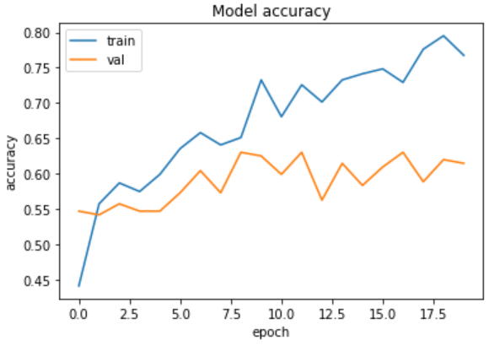
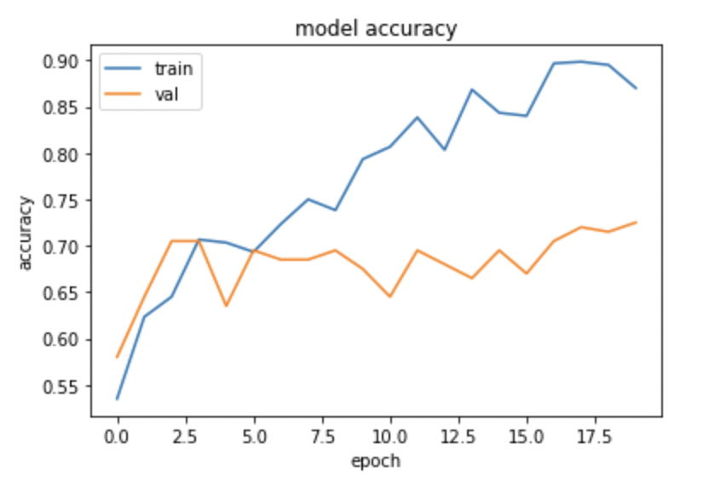
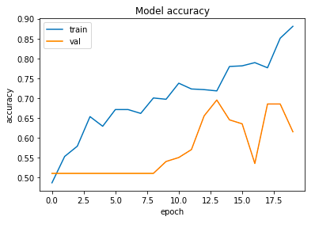
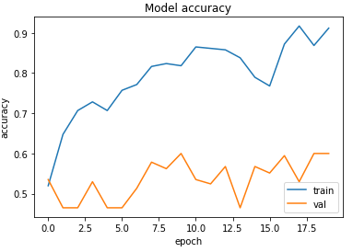
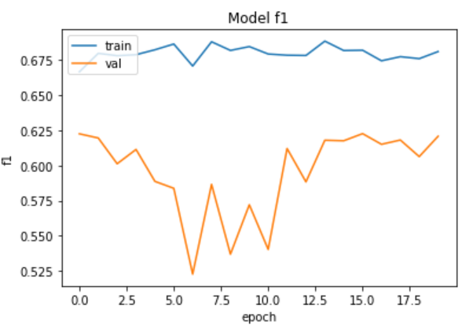
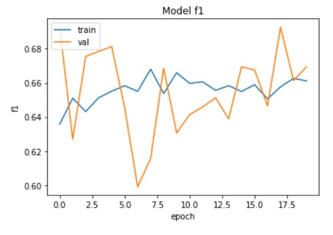
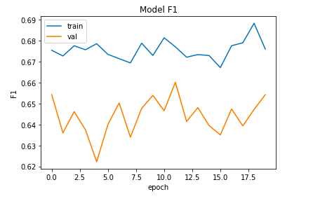
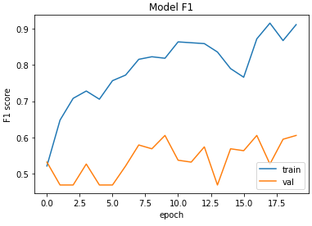
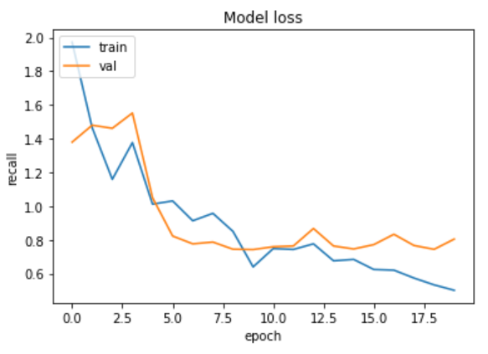
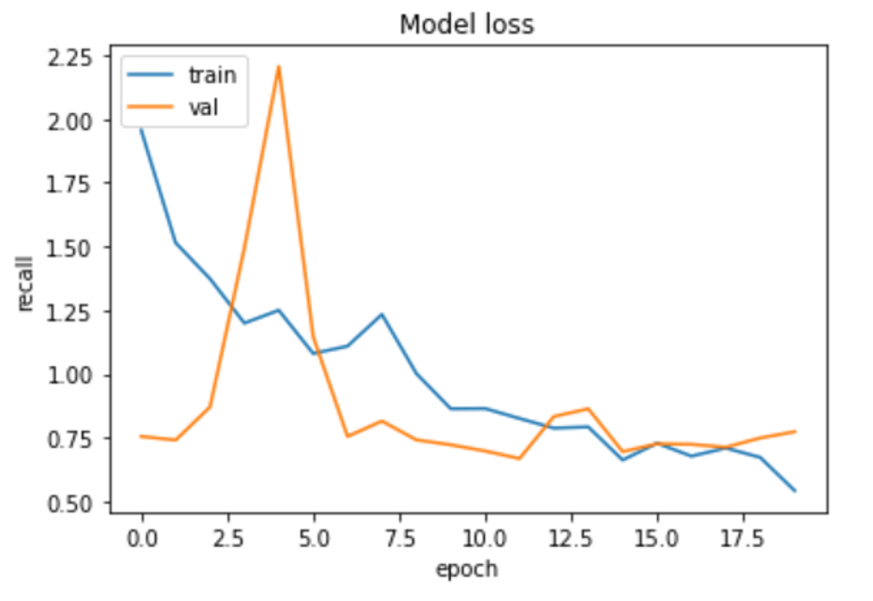
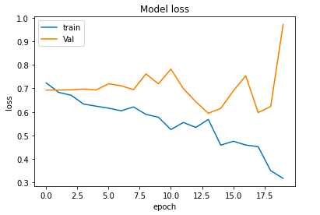
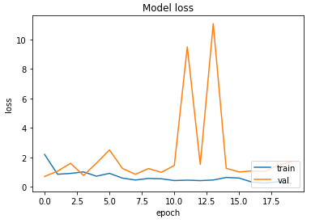
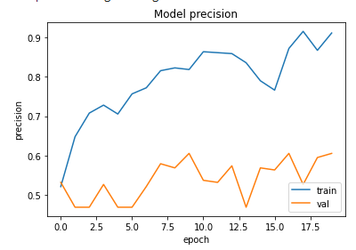
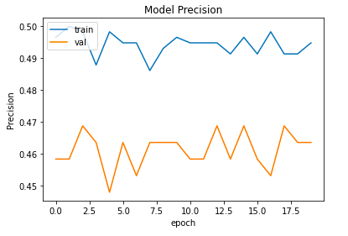

Characteristic | AlexNet | VGGNet | GoogleNet | ResNet
Accuracy
F1
Loss
Precision

Slide 32
INNOVATION
Leverage social media images for flood image classification rather than satellite images and Unmanned Aerial Vehicles (UAV)
Deep Learning based CNN methods are leveraged as opposed to traditional threshold-based methods and other machine learning techniques

Slide 33
REFERENCES
Ali, A. (2022, January 23). OpenCV normalize images. Delft Stack. Retrieved November 4, 2022, from https://www.delftstack.com/howto/python/opencv-normalize/
Brownlee, J. (2019, July 5). Best practices for preparing and augmenting image data for cnns.
Machine Learning Mastery. Retrieved November 4, 2022, from https://machinelearningmastery.com/best-practices-for-preparing-and-augmenting-image- data-for-convolutional-neural-networks/
Dey, V. (2021, August 20). Guide to image reconstruction using principal component analysis.
Analytics India Magazine. Retrieved November 4, 2022, from https://analyticsindiamag.com/guide-to-image-reconstruction-using-principal-component- analysis/
Environmental Protection Agency. (n.d.). EPA. Retrieved November 4, 2022, from https://www.epa.gov/caddis-vol4/exploratory-data-analysis
Hui, Jonathan. “Machine Learning - Singular Value Decomposition (SVD) &amp; Principal Component Analysis (PCA).” Medium, Medium, 8 Feb. 2022, https://jonathan-hui.medium.com/machine-learning-singular-value-decomposition-svd-principal-component-analysis-pca-1d45e885e491#:~:text=What%20is%20the%20difference%20between,PCA%20skips%20less%20significant%20components.
Image compression using principal component analysis (PCA). (n.d.). Retrieved November 4, 2022, from https://towardsdatascience.com/image-compression-using-principal- component-analysis-pca-253f26740a9f
Image data pre-processing for Neural Networks - medium. (n.d.). Retrieved November 4, 2022, from https://becominghuman
Image denoising. OpenCV. (n.d.). Retrieved November 4, 2022, from https://docs.opencv.org/3.4/d5/d69/tutorial_py_non_local_means.html.ai/image-data-pre-processing-for-neural-networks-498289068258
ImageStat module. ImageStat Module - Pillow (PIL) examples. (n.d.). Retrieved November 4, 2022, from https://hhsprings.bitbucket.io/docs/programming/examples/python/PIL/ImageStat.html
Introduction to principal component analysis (PCA). OpenCV. (n.d.). Retrieved November 4, 2022, from https://docs.opencv.org/3.4/d1/dee/tutorial_introduction_to_pca.html
Kumar, R. (2021, July 9). CV2 normalize() in python explained with examples. Python Pool.Retrieved November 4, 2022, from https://www.pythonpool.com/cv2-normalize/
Lendave, V. (2021, September 22). A guide to different types of noises and image denoising methods. Analytics India Magazine. Retrieved November 4, 2022, from https://analyticsindiamag.com/a-guide-to-different-types-of-noises-and-image-denoising- methods/
Lyashenko, V. (2022, July 21). Data Augmentation in python: Everything you need to know. neptune.ai. Retrieved November 4, 2022, from https://neptune.ai/blog/data-augmentation- in-python
Madhugiri, D. (2022, April 22). Learn image augmentation using 3 popular python libraries.
Analytics Vidhya. Retrieved November 4, 2022, from https://www.analyticsvidhya.com/blog/2022/04/image-augmentation-using-python- libraries
Medic dataset. CrisisNLP. (n.d.). Retrieved November 4, 2022, from https://crisisnlp.qcri.org/medic/
Mirzarahim. (2019, September 9). Introduction to PCA: Image compression example. Kaggle.
Retrieved November 4, 2022, from https://www.kaggle.com/code/mirzarahim/introduction-to-pca-image-compression- example/notebook
Operations with images. OpenCV. (n.d.). Retrieved November 4, 2022, from https://docs.opencv.org/3.4/d5/d98/tutorial_mat_operations.html
Peng, M. L. (2018, May 15). Improving neural networks by preventing co-adaptation of feature detectors. Medium. Retrieved November 4, 2022, from https://medium.com/@lipeng2/dropout-is-so-important-e517bbe3ffcc
Praveen. (2020, July 28). How to find HSV range of an object for computer vision applications?
Medium. Retrieved November 4, 2022, from https://medium.com/programming- fever/how-to-find-hsv-range-of-an-object-for-computer-vision-applications-254a8eb039fc
Principal component analysis: In-depth understanding through image ... (n.d.). Retrieved November 4, 2022, from https://towardsdatascience.com/principal-component-analysis-in- depth-understanding-through-image-visualization-892922f77d9f
Rausch, D. (2021, April 15). EDA for image classification. Medium. Retrieved November 4, 2022, from https://medium.com/geekculture/eda-for-image-classification-dcada9f2567a
Smoothing images. OpenCV. (n.d.). Retrieved November 4, 2022, from https://opencv24-python- tutorials.readthedocs.io/en/latest/py_tutorials/py_imgproc/py_filtering/py_filtering.h

Slide 34


Thank you

